Slide 1
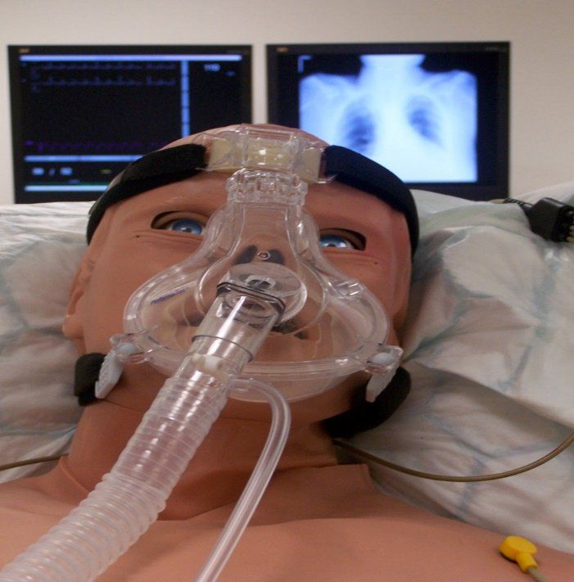
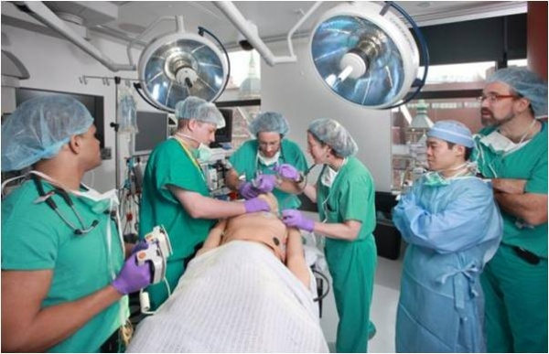
DREAD Analysis: defence and mitigation Team 3
Based on Compromising a Medical Mannequin (Glisson at al, 2015)

Slide 2
 | Damage | Reproducibility | Exploitability | Affected users | Discoverability | Total | Risk level
Example: Phished password | 2 | 1 | 3 | 2 | 2 | 13 | High
Brute force: Weak password
Denial of Service
Password manager
Credit monitoring

Slide 3
Defence and mitigation
(JA)
Use VLAN to isolate or segment network
Deactivate uPnp and WPS
Use long complex alpha-numeric passwords with symbols:!Afdh1.2c&
(AA)
Active Two-Step Authentication (2SA) if possible
Use a security question that cant be easy to guess the answer
Do not link your account to Facebook or Instagram it make it easy to breaches
?
?

